Slide 1
Stern data bootcamp Session 1
2022-02-02

Slide 2
Agenda
Introduction
The data science landscape

Slide 3
Context and objectives
This class is the NYU Stern data bootcamp
Objectives:
Explain why we’re here so you can decide whether this is the class for you
Preview the next 13 weeks
Install the software you’ll need for the class
Run your first programs

Slide 4
What’s in it for you?
Businesses like data
Fluency in data analysis norms and techniques is high variance
Obtaining this skill – even at what you might consider a low level – will differentiate you from your peers
Your depth
Specialist
Valuable to one team but limited ability to solve real business problems
Partner
Connects teams and adds unique, domain-specific expertise
Widget
Brings nothing unique and is also hard to imagine in another role
Generalist
Can shuffle from role to role but hits an invisible ceiling in each one
Your breadth

Slide 5
Why learn to code?
Coding is fun
Programming languages can handle much larger datasets than Excel
For many tasks, a small amount of code accomplishes what would require a nightmarish Excel formula

Slide 6
Tools we will use
Python programming language
Anaconda and Jupyter development environments
SQL database query language
MySQL Workbench development environment
Google
Often the quickest way to get to StackOverflow, with which you will become very familiar
ChatGPT
Provides great starting points and explanations for many coding challenges

Slide 7

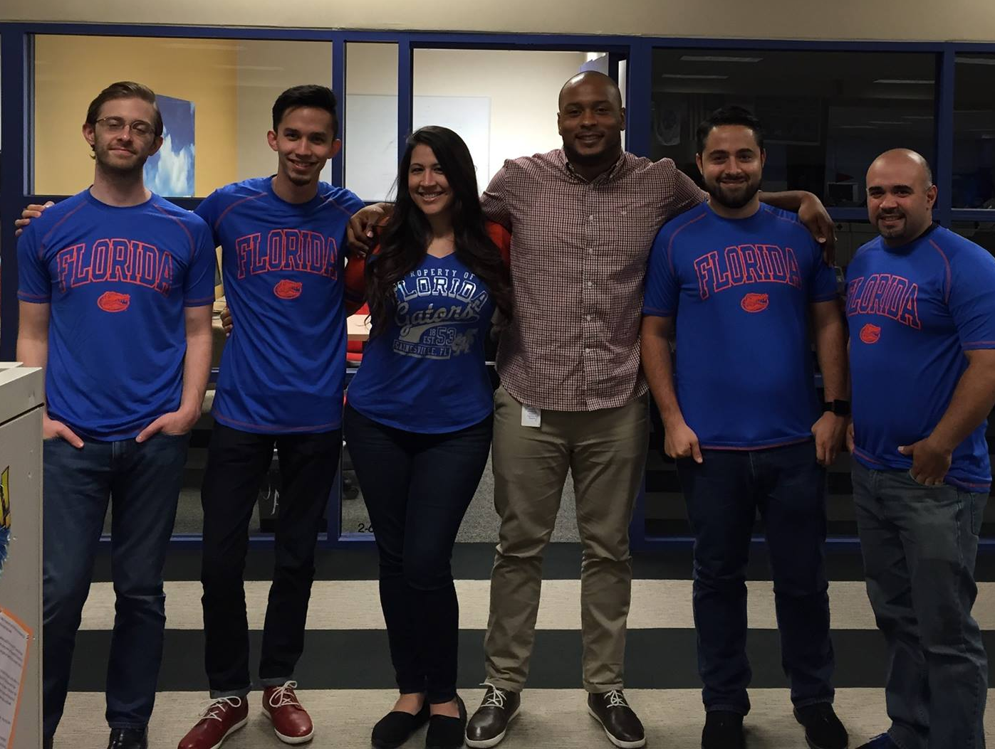



Jack of like, two or three trades Master of none
2007 – 2013
Orchestral music
2013 – 2017
Test prep
2017 – 2022
Business
2022 – present
Life sciences

Slide 8
Agenda
Introduction
The data science landscape

Slide 9
”Data science” is a broad term
// ILLUSTRATIVE
Less technical
More technical
Generalist
Business analyst
Database analyst
Data scientist
ML engineer
Data analyst
SQL analyst
Python / R developer
AI architect
Marketing analyst
Visualization engineer
Python / R engineer
NLP engineer
Finance analyst
Hadoop engineer
Geospatial data scientist
Computer vision engineer
Specialist
…
…
…
…
Cross-functional roles
ML ops (analyst, engineer, manager, director, etc)
Data ops (analyst, engineer, manager, director, etc)
Infrastructure (engineer, developer, manager, director, etc)
Business (various roles)

Slide 10
There are lots of entry points to doing data science, and you can probably start right now, regardless of your current job title
// ILLUSTRATIVE
Less technical
More technical
Generalist
Business analyst
SQL analyst
Data scientist
ML engineer
Data analyst
Tableau developer
Python / R developer
AI architect
Marketing analyst
Visualization engineer
Python / R engineer
NLP engineer
Finance analyst
Hadoop engineer
Geospatial data scientist
Computer vision engineer
Specialist
Cross-functional roles
ML ops (analyst, engineer, manager, director, etc)
Data ops (analyst, engineer, manager, director, etc)
Infrastructure (engineer, developer, manager, director, etc)
Business (various roles)

Slide 11
Data science is kind of a personality test
These are good…
…but these are more important over time
Numeric intuition
Statistics knowledge
Coding background
CS degree
Stats degree
Decades of work experience
Determination
Patience
Ability to use Google
Willingness to steal
Ability to overcome impostor syndrome
Thick skin when someone on StackOverflow is rude to you

Slide 12
Writing data science / ML / AI code is a necessary but small part of creating value
Writing code

Slide 13
Writing data science / ML / AI code is a necessary but small part of creating value
Configuration
Data collection
Data verification
Machine resource management
Serving
Monitoring
Writing code
Analysis tools
Feature extraction
Process management

Slide 14
For people on the business side, the ML pipeline itself is only one aspect of creating value
Communication
Coordination and project management
Business case
Configuration
Data collection
Data verification
Machine resource management
Serving
Monitoring
Writing code
Analysis tools
Feature extraction
Process management

Slide 15
ML projects follow a general lifecycle, with much cycling back and forth among stages
Scoping
Data
Modeling
Deployment
Define project
Define and establish baseline
Label and organize data
Select and train model
Perform error analysis
Deploy in production
Monitor and maintain system

Slide 16
The right map leads to the right destination
Scoping
Data
Modeling
Deployment
Define project
Define and establish baseline
Label and organize data
Select and train model
Perform error analysis
Deploy in production
Monitor and maintain system
Define the project to be addressed
Agree on key metrics (e.g., cost, revenue growth, churn, factory defect rate, etc)
Estimate budget and other resource needs

Slide 17
Agenda
Introduction
The data science landscape

